Slide 1
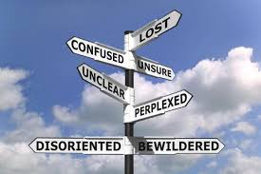
Follow Me
March 17th, 2019

Slide 2
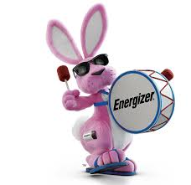
Symbols
Disney World…the happiest place in the world.
Nike…Just do it.
Energizer. Keep going and going and going

Slide 3
Symbols
Howard County Church of Christ
To imitate Christ by humbly serving, loving, and sharing the gospel that all may be brought into a growing relationship with God

Slide 4
Why Would Anyone Follow Us to HC³
Humility
Compassion
Courage
Competent
H
C
C
C
H
Compassion
Courage
Competent
H
C
C
Competent
H
C
Courage
Competent
2 Corinthians 1:3-4; Colossians 3:12
Mark 14: 32-42; Acts 7:54-60; 14:8-20
Proverbs 2:1-10; 4:6-7
Do nothing out of selfish ambition or vain conceit. Rather, in humility value others above yourselves
- Philippians 2:3

Slide 5
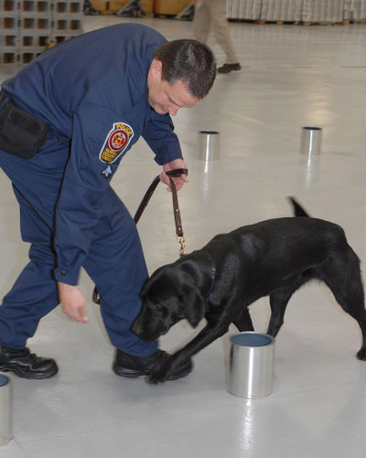
What do you see?
Our vision of a plentiful harvest here at HC³ will become a reality when we own our role as ones who are called to lead the lost to Christ

