Slide 1
Sermon on the Mount Part IV: The Golden Rule For The Golden Path
Matthew 7
February 17th, 2019

Slide 2
Avoiding the Pitfalls On Our Journey Down The Golden Path
Matthew 7
What direction is your correction?
Judging others is an attempt to take God’s Place
Focusing on how we can grow closer to Christ is the best way to help correct the sin of others
Who is giving you direction?
Direction from others will be Christ like if the fruit they produce is Christ like
Are you paying attention to your footing?

Slide 3
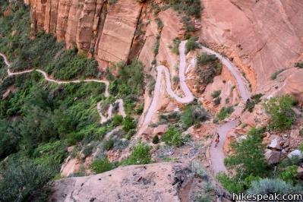
Avoiding the Pitfalls On Our Journey Down The Golden Path
Are you paying attention to your footing?
Jesus didn’t give the sermon on the mount to be relevant or popular, but to build a foundation of hope and truth held together with love and grace.
The Angel’s Landing Trail In Zion National Park

