Slide 1
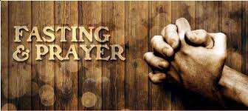
Sermon on the Mount Part III: Are You Responding To God?
Matthew 6
February 10th, 2019

Slide 2
Examples of Our Responses To God
Matthew 6:1-18
Giving To The Needy
If our focus is on God as we give, we realize how much we have been given
Prayer
Praying completely focused on God with the perspective given by Christ will allow us to see the true power of prayer
Fasting
Sacrificing in the name of the Lord should have an audience of one

Slide 3
Indirect Responses To God
Treasures In Heaven
Matthew 6:19-25
What we treasure shows God and us who we serve
Worries of Tomorrow
Matthew 6:26-34
Energy focused on the anxiety of the unknowns of tomorrow must be replaced with faith in the promises of a tomorrow owned by Christ

