Slide 1
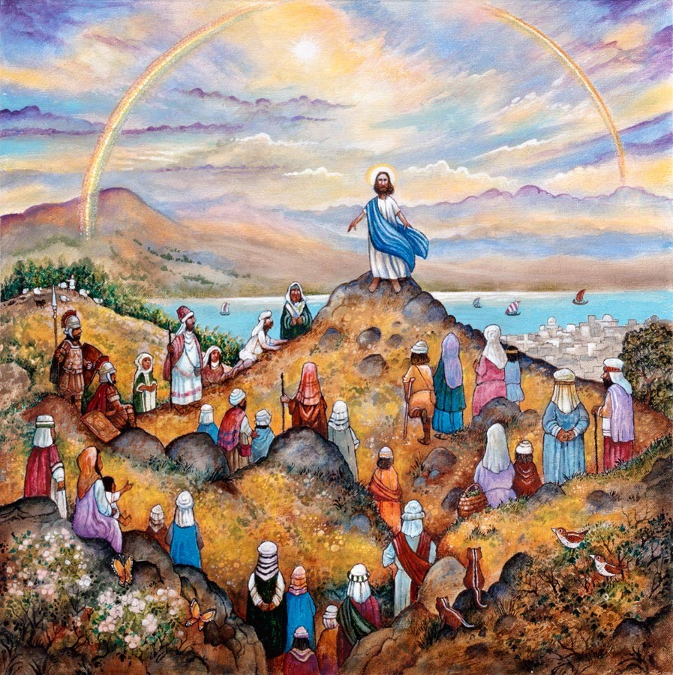
Sermon on the Mount Part I Road to Being Blessed
Matthew 5:1-16
January 27th, 2019

Slide 2
The Sermon on the Mount
Christ lived as he said
Matthew 4:23, 9:35
The message was delivered to the disciples with the power to awaken a deep desire in all
Christ begins His most powerful sermon with the formula for being truly blessed
Matthew 5:1-12

Slide 3
Matthew 5: 1-12
5 Seeing the crowds, he went up on the mountain, and when he sat down, his disciples came to him.
² And he opened his mouth and taught them, saying:
³ “Blessed are the poor in spirit, for theirs is the kingdom of heaven.
⁴ “Blessed are those who mourn, for they shall be comforted.
⁵ “Blessed are the meek, for they shall inherit the earth.
⁶ “Blessed are those who hunger and thirst for righteousness, for they shall be satisfied.
⁷ “Blessed are the merciful, for they shall receive mercy.
⁸ “Blessed are the pure in heart, for they shall see God.
⁹ “Blessed are the peacemakers, for they shall be called sons of God.
¹⁰ “Blessed are those who are persecuted for righteousness' sake, for theirs is the kingdom of heaven.
¹¹ “Blessed are you when others revile you and persecute you and utter all kinds of evil against you falsely on my account. ¹² Rejoice and be glad, for your reward is great in heaven, for so they persecuted the prophets who were before you.

Slide 4
Beatitudes
Jesus’s message stands in direct opposition for the world’s formula of being blessed
The Beatitudes are built with six promises sandwiched between two assurances of the Kingdom of God
The first step to being blessed is the recognition of how poor in Spirt we are
Revelations 3:17-22

Slide 5
Promises that Come with Being Blessed?
For they will be comforted
Mourning our sin leads to repentance and changing to God’s path that is led by the comfort of the Holy Spirit
For they will inherit the earth
Meekness gives us the strength to take back our lives from Satan’s grasp knowing God’s inheritance is promised
For they will be filled
The path to being blessed will cause a thirst and hunger only the Lord can satisfy

Slide 6
Promises that Come with Being Blessed?
For they will receive mercy
Being merciful to man returns mercy from God, not man
For they will see God
Walking with Jesus, imitating His actions, absorbing His training produces more of Him and less of us in our hearts
For they will be called children of God
Building bridges from the lost to Christ requires ambassadors tasked to be peacemakers

Slide 7
Assurance That Our Reward is Great
We must know that the path to being blessed leads us to be more Christ like.
John 15:18-27
We see the assurances and promises that come with being blessed, can we now walk this path?
Matthew 5:13-16
Remember this was not just preached by Jesus but lived. What will we do with this message?

