Slide 1
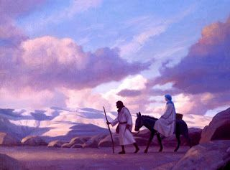
The Unseen Journey
December 16th, 2018

Slide 2
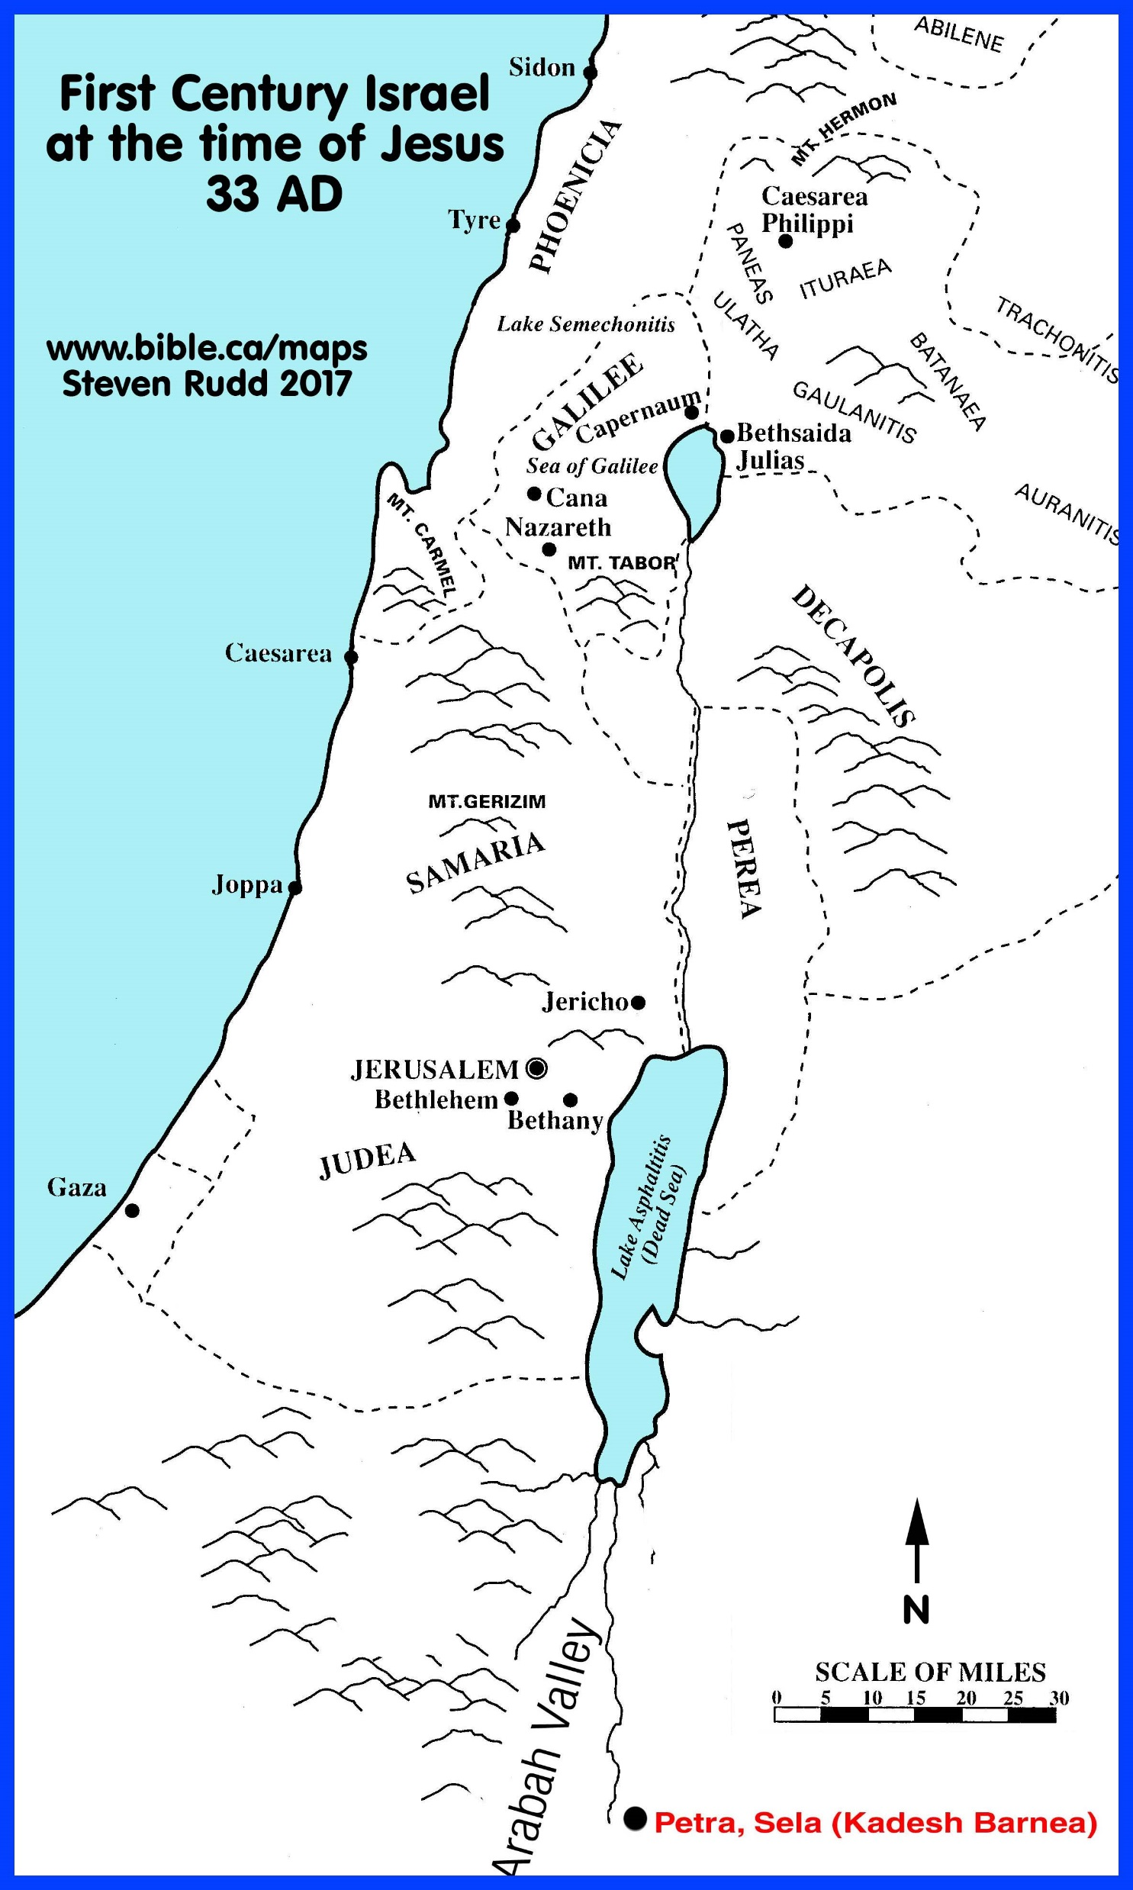
What Do We See On Our Journey?
Are we focusing on our obstacles or God working through them?
How do you think Mary and Joseph would have answered?
Luke 2:1-7; Hebrews 11:1-3
What results do we see from our journey in life?
Matthew 25:34-40
Why must we take the journey?
John 1:10-13; Matthew 5: 14-16
How should we prepare for our journey??
Nazareth
Bethlehem

