Slide 1
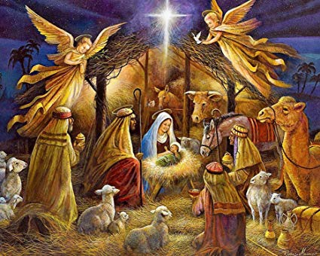
Nativity of Courage
December 9th, 2018

Slide 2
Definition
Nativity: the process or circumstances of being born
Courage: mental or moral strength to venture, persevere, and withstand danger, fear, or difficulty

Slide 3
Where Is Our Courage Born?
The Example of the Virgin
Luke 1:26-38, 46-55
Mary traded her life for her God
Mary’s trust outweighed her fear
Mary’s strength was in her humility
Mary’s hope was in a past promise from a present God about a future of peace

Slide 4
Where Is Our Courage Born?
The Example of the Husband
Matthew 1:18-24; 2:13-24
Joseph’s heart outweighed his pride
Joseph sacrificed his place as a father to be a child of God
Joseph allowed the Spirit to lead
Joseph was a great eagle in the middle of a great war
Revelation 12:13-14

Slide 5
Where Is Our Courage Born?
The Example of the Shepherds
Luke 2:8-20
The Shepherds didn’t allow the fear of the moment to rob an experience of a lifetime
The Shepherds allowed God to calm their fears
The Shepherds left their livelihood to seek Jesus
The Shepherds shared the glory of their God

Slide 6
Where Is Our Courage Born?
The Example of the Magi
Matthew 2:1-12
The Magi used their years of study to seek the Messiah
The Magi chose allegiance with a child over a King
The Magi abandoned earthly power to honor Christ

Slide 7
What Does Our Nativity of Courage Look Like?
Is it full of willingness to give of one’s self based off the hope in Christ?
Is it producing a heart that will soar over our pride?
Will it seek Christ amongst the fear of a moment?
Will it thrive on humility seeking Christ over earthly kings?
Will you allow the Child to triumph the Dragon in your life?
Revelation 12:9-12

