Slide 1
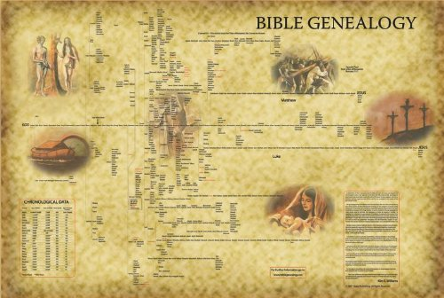
Christ Family Tree
November 18th, 2018

Slide 2
What Do We Need To Know About The Genealogy of Jesus Christ?
Genealogy of Christ confirms the truth of God’s Word
Lineage of Christ goes through the line of Abraham and David as promised by God
Genesis 12, 26, 35
The Bloodline of Christ is from the line of Judah
Genesis 49:10; Isaiah 11:1-5; 2 Samuel 7:8-16; Luke 1:29-33
The recordings of Luke and John prove Christ was both Man and God
Luke 1:29-33; John 1:1

Slide 3
What Do We Need To Know About The Genealogy of Jesus Christ?
Your past cannot be used as an excuse to not serve God
Abraham and David prove God uses a different scale to judge faith and hearts
Women like Tamar, Rahab, Ruth, and Bathsheba prove that God doesn’t see worldly boundaries or people as outsiders
God’s use of wicked kings and sinful personalities shows us that He can work through anyone
John 1:9-14

Slide 4
What Do We Need To Know About The Genealogy of Jesus Christ?
God shows us through Christ’s genealogy that Jesus is the only person qualified to be the Savior of the world
Jesus has the blood of man but the heart of God and speaks truth with grace and love
Luke 1:26-38; John 1: 14-18
The second greatest gift from God’s love is free will
The greatest gift from God’s love is salvation from our sin
John 3:16-20

Slide 5
Like a Rose
The World has no use for handled roses
God sees the beauty in all of us and wants to restore us to that perfect rose
Are you willing to accept this gift and join a family of Royalty?
Romans 8:1-4

