Slide 1
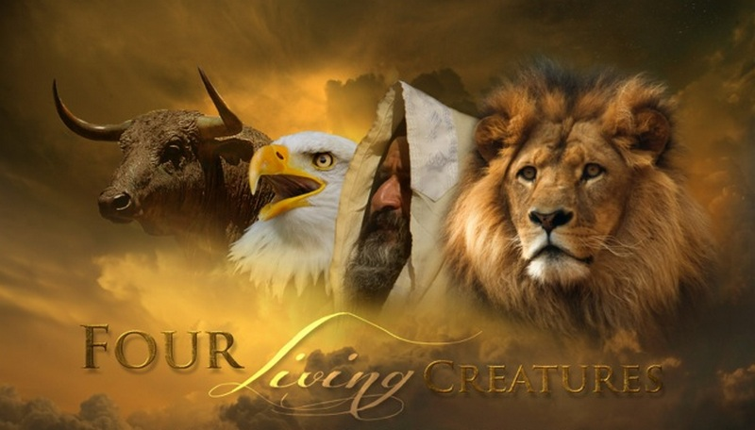
The Gospels of Christ
November 4th, 2018

Slide 2
Why Four?
Maybe God wanted us to behold who Christ really is
Behold means to see, observe, survey, witness, regard, contemplate, and it’s the same word used by Prophets to describe the coming Messiah
Isaiah writes: Behold your God (Isaiah 40:9-11)
Isaiah writes: Behold my Servant (Isaiah 42:1-4)
Zechariah writes: Behold the Man (Zechariah 6:12-13)
Zechariah writes: Behold your King (Zechariah 9:9)

Slide 3
What do the Gospels really look and sound like?
Ezekiel 1
A creature in human form with a face of a man, a lion, an ox, and an eagle with eyes all over them who would move at the direction of the Spirit
A Voice like a roar of rushing water from above like that of the Almighty
A sound and appearance that humbles you to the core
Revelation 4
Four creatures, face of a lion, ox, man, flying eagle all with eyes all around them night and day speaking the Gospel
Carrying a message that causes elders to give up their crown in worship of the Lord Almighty

Slide 4
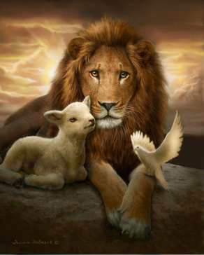
Gospel of the King: Matthew
Matthew provides clear evidence of Jesus’s Kingship.
It starts with the lineage of a King in Chapter 1:1
From His Birth to death he was called the King of the Jews
So what message would the Gospel of Matthew speak to us if we behold it as the Gospel of the King

Slide 5
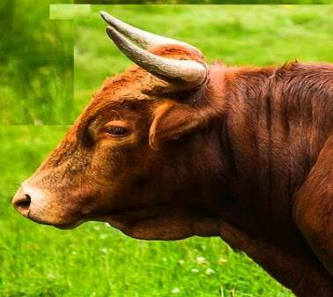
The Gospel of the Servant: Mark
The Gospel of Mark has a servant’s theme
Mark portrays Jesus’ life as a suffering servant
No lineage of Christ which fits a servant’s life
Jesus is not called Lord until after resurrection
Mark’s life is also a great example of a servant
What would the Gospel of Mark say to us if we read it seeking our Lord and Savior, our Servant

Slide 6
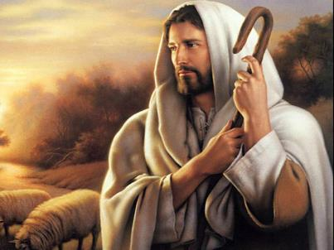
The Gospel of the Man of God: Luke
The Gospel of Luke shows us the humanity of Christ
Luke provides an orderly account of the Man Jesus
Luke traces Christ lineage not from kings but all the way to Adam, the beginning of mankind
Luke’s writing depict many examples of Christ in the act of prayer, man’s proper relationship to God
What could the Gospel that describes Christ the man as weeping teach us about the power and love of our Savior

Slide 7
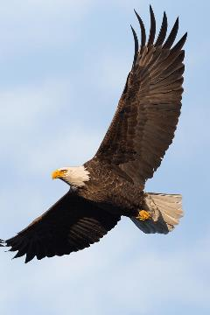
The Gospel of the One True God: John
The Gospel of John waste no time in stating who the Messiah was, is and is to come
There are seven declarations of “I am”
John’s writings clearly show Christ’s proclamation of His deity and life saving power
John’s purpose for his Gospel is clear in Chapter 20:30-31, so what can we learn from the Soaring Eagle our Messiah?

Slide 8
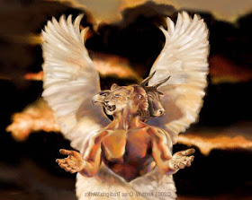
So What Do We Do With The Gospels?
We behold them
As we see, observe, survey, witness, regard, contemplate the living words from the Lion, the Ox, the Man, and the God, simple ask these questions
Who is Jesus Christ to us?
How are we going to respond?

