Slide 2
Self-government
Colossians 3:15-17

Slide 3
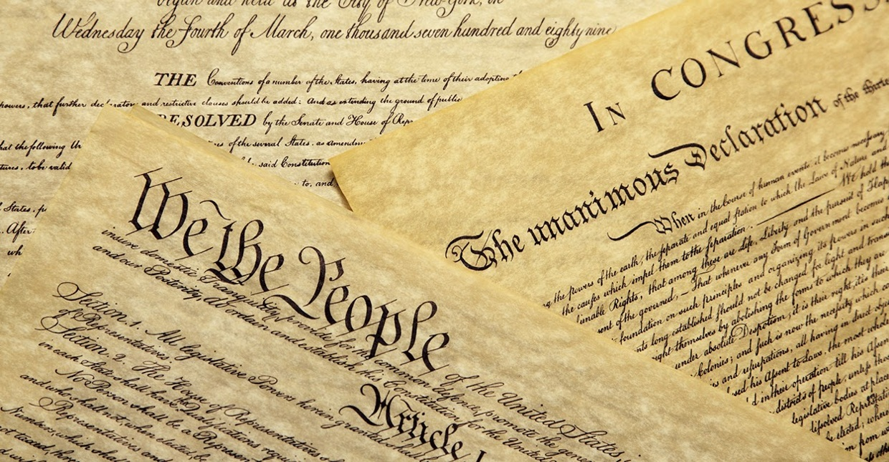

Slide 6
Colossians 3:15
And let the peace of Christ rule in your hearts, to which indeed you were called in one body. And be thankful

Slide 7
Ruled
by the peace of Christ

Slide 8
A command
that you cannot do

Slide 9
Ruled
in your heart

Slide 10
What is
the peace of Christ?

Slide 11
Matthew 10:34–39
[34] “Do not think that I have come to bring peace to the earth. I have not come to bring peace, but a sword. [35] For I have come to set a man against his father, and a daughter against her mother, and a daughter-in-law against her mother-in-law. [36] And a person's enemies will be those of his own household. [37] Whoever loves father or mother more than me is not worthy of me, and whoever loves son or daughter more than me is not worthy of me. [38] And whoever does not take his cross and follow me is not worthy of me. [39] Whoever finds his life will lose it, and whoever loses his life for my sake will find it. (ESV)

Slide 12
Romans 5:1
Peace with God Through Faith
[1] Therefore, since we have been justified by faith, we have peace with God through our Lord Jesus Christ. (ESV)
Romans 8:5–6
[5] For those who live according to the flesh set their minds on the things of the flesh, but those who live according to the Spirit set their minds on the things of the Spirit. [6] For to set the mind on the flesh is death, but to set the mind on the Spirit is life and peace. (ESV)

