Slide 2
Overalls for clothing our self
Colossians 3:14-17

Slide 3
Review
The new self is created in the image of God
Exodus 34:5-7

Slide 4
Above all put on love?
A Hypothesis

Slide 5
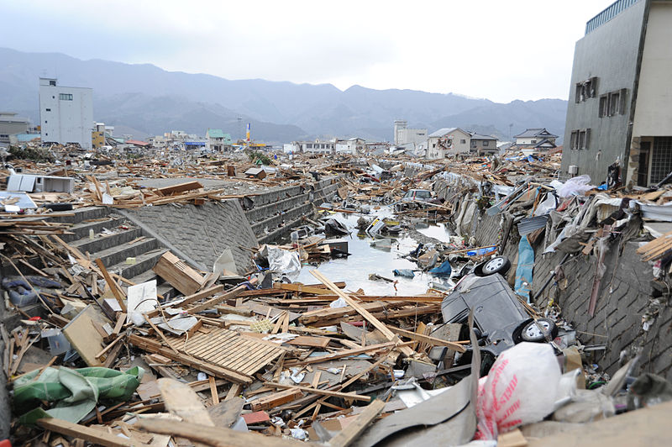

Slide 7
Love is overlaid

Slide 8
Checklist danger

Slide 9
What is love?

Slide 10
Bound together

