Slide 1
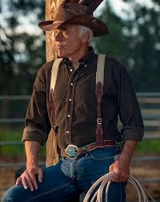
A Belt and Suspender Christian Genesis Chapter 21
February 4th, 2018

Slide 2
What We Learn From The Birth Of Isaac
God’s promises are never business as usual
God’s timing must be trusted
God’s promise are defined and delivered

Slide 3
What We Learn From Hagar
Abraham’s response teaches us God is our source for clarity
Hagar’s response teaches us God is always listening
God teaches us to forgive ourselves and believe in His promises

Slide 4
What in your life do you need to release to believe in God’s promises?

