Slide 1
The Great Lesson In Silence Genesis Chapter 17
January 7th, 2018

Slide 2
WAIT
Walk a little slower
Ask God for increased patience, wisdom, and self-control
Imagine the worst-case scenario that might happen if you waited instead of running ahead
Think of how your decision impacts others

Slide 3
God’s Silence
Two major differences between this appearance of God and the last one:
God refers to himself as El Shaddai: God Almighty
Abram is a changed man
God simple message:
While I am sometimes silent, I remain in control of your circumstance

Slide 4
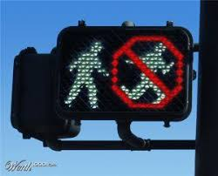
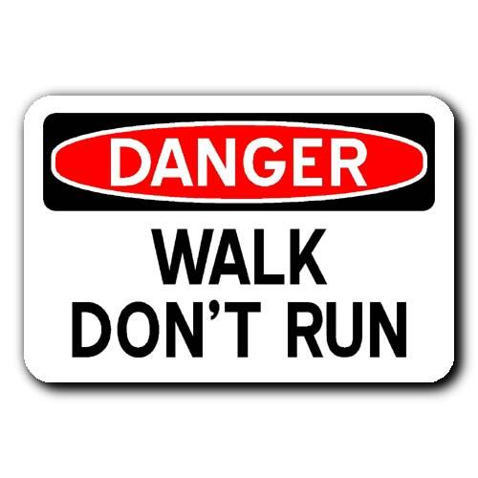
Walk Don’t Run
To hear God’s voice over the crowd, we too must practice walking to God’s cadence
Blameless is achieved not by being sinless, but by walking with God
Psalm 15: 1-5; Philippians 2: 12-16

Slide 5
The Covenant of Circumcision
Abraham was called to be a keeper of the Covenant
God’s circumcision command wasn’t to earn salvation but to remind them of His Grace
Romans 3:19-20
Sarah’s name shows all of us the miraculous power of El-Shaddi

Slide 6
Growing Deeper
God’s message is simple, slow down, walk to His Cadence, and then repeat for a lifetime.
In God’s silence you will find discernment, freedom from anxiety, and avoid unnecessary pitfalls and tragedy

