Slide 1
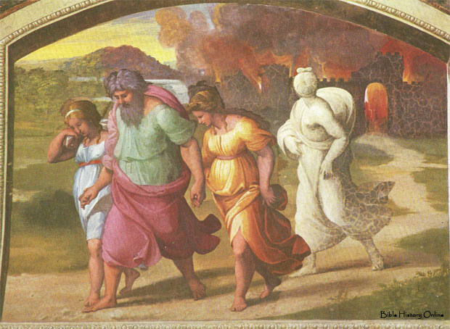
Deathly Hallows Genesis Chapter 19
January 21st, 2018

Slide 2
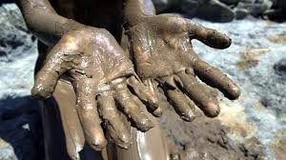
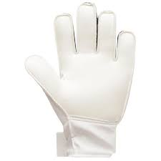
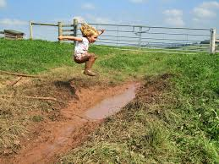
“Glovey” Mud?

Slide 3
Contaminated Convictions
Tolerance of immorality will contaminate your convictions
Your choices based off your convictions should align with God’s Word not the acceptable practices of your environment
If you have to pack for heaven, you are not ready for heaven
Luke 17: 26-33

Slide 4
What condition are your convictions? Are they still hallow before the Lord or have they been compromised by the Sodom of today?

