Slide 1
Sovereign Lord
December 10th, 2017

Slide 2
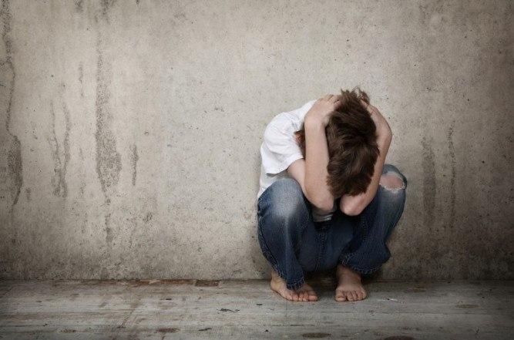
Definition of Fear: an unpleasant often strong emotion caused by anticipation or awareness of danger

Slide 3
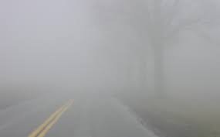
Abram’s Fear
Genesis 15:1-3
Abram’s fear comes through reflection of his life
When we fail to put our life in the hands of God, the fog of fear will overcome us
Isaiah 35:3-4; John 14:27

Slide 4
Art of Conversation
Genesis 15: 1-7
To overcome fear, lean on the Father
Knowing God has initiated the conversation, we must open our ears to hear and our hearts to receive
Matthew 13: 16-17
Understand who God is and believe in Him
Romans 4

Slide 5
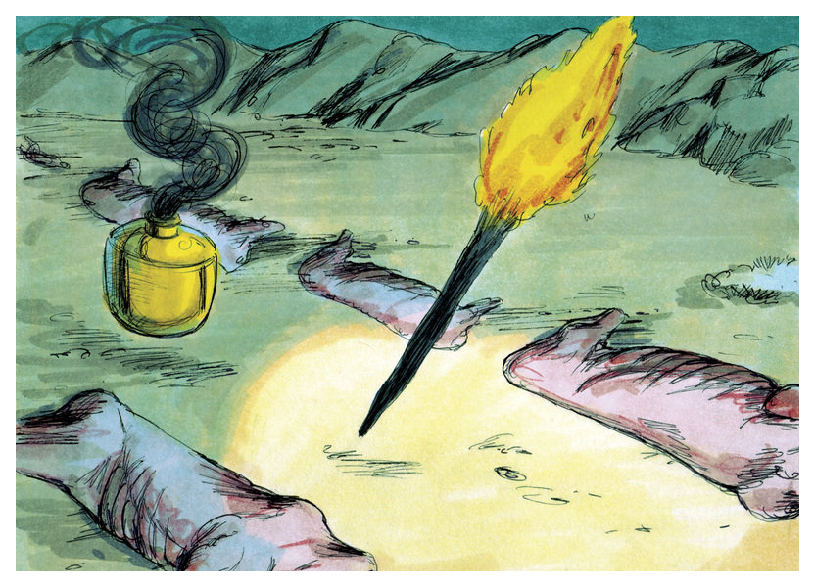
Signed Covenant
Genesis 15: 8-21
During Abram’s time there were no ink and paper contracts signed with binding signatures
The ritual that God calls Abram to do was familiar to Abram
Passing between halved animals stated: “May the same thing happen to me if I break my promise”
This custom gave rise to the Hebrew expression “cut a covenant”

Slide 6
Signed and Delivered
God’s signed covenant shows us:
He will calm our fears if we trust in Him
He knows when to bless and when to delay
His plan is good and bigger than we can imagine

Slide 7
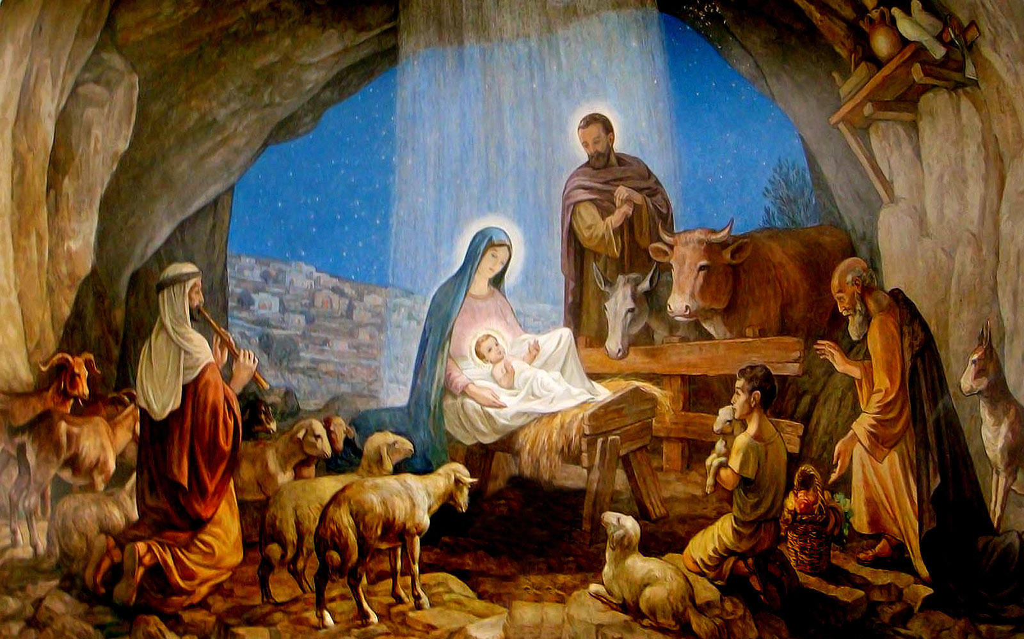
Is there room in your heart for God to calm your fears with His Covenant?
Romans 5:1-2

