Slide 1
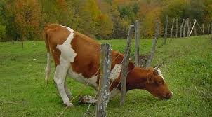
The Search For Greener Grass
November 26th, 2017

Slide 2
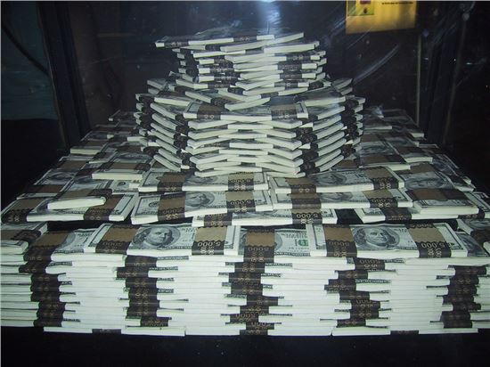
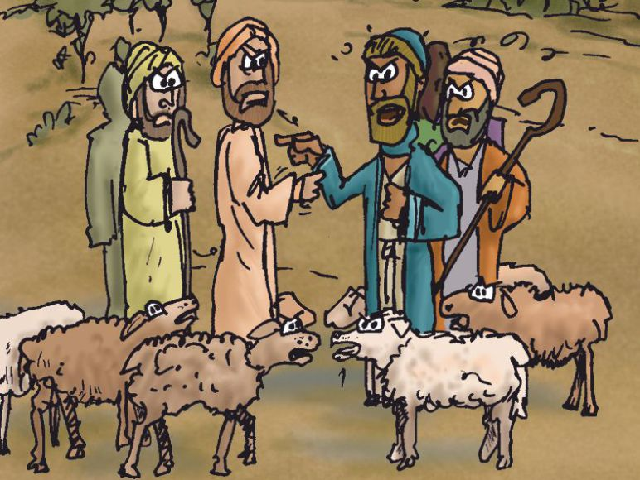
The Crisis of Prosperity
Genesis 13:2-7
It's more likely you'll get struck by lightning than win the Powerball — but if you do win, there is an even better chance that you'll go broke. Nearly 70% of lottery winners end up broke within seven years.
“Adversity is sometimes hard upon a man; but for one man who can stand prosperity, there are a hundred that will stand adversity”
Alexander Whyte

Slide 3
Reaping The Harvest From A Season of Learning
Genesis 13: 8-13
If you let them, your worldly rights may prevent you from following God’s plan
Abram’s response showed a desire for family over feud, faith over self, and God to the Curious
John 17: 20-23
Lot’s response showed a desire for entitlement over family, and an alliance with the world over God
Proverbs 28: 25-26; 1 John 2: 15-17; Hebrews 13: 5-6

Slide 4
The Makeup of a Godly Decision
Genesis 13: 14-18
Always look beyond the immediate positive benefits of a decision to focus on God’s plan
Never underestimate the impact of negative consequences
Forget about pleasing yourself and seek humility
Philippians 2:1-8
Remember independence without God is a fool’s freedom that is here today and gone tomorrow
Matthew 6:33

Slide 5
Learn from Abram
Like Abram, seek communion with the Lord
With God, you can see pass the Sodom and Gomorrah’s of your life

