Slide 1
Default Response
November 19th, 2017

Slide 2
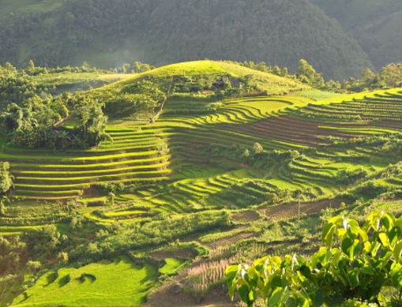
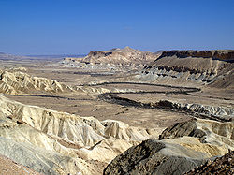
Negev – The Delicate Balance of Life
Mesopotamia
Genesis 12: 6-10
Negev means “dry parched”
Severe famine could have been caused by drought diseased crops, plague of locusts, or simply a failed harvest
Margin to handle stress in Negev not as great as the banks of the Euphrates River
Abram was a newcomer from a very different land
Negev

Slide 3
Egypt – An Alliance With The World
Genesis 12: 11-16
Abram default response included three major mistakes
Abram failed to realize that fear of man is incompatible with faith in God
Proverbs 29:25; 2 Peter 1:4-9
Abram’s lack of faith made him nearsighted and he failed to seek God’s plan
Luke 12:48
Abram became self-serving

Slide 4
The End Does Not Justify The Means
Success from faithless actions, does not equal a blessing from God
Allow God to rescue you and give you a chance to return to the life of Faith
Genesis 13:1-4

Slide 5
Learn from Abram
Every Abram struggles with a weakness in their walk
Seek the season of learning by calling upon the Lord

