Slide 1
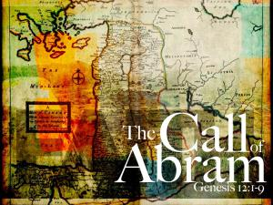
November 12th, 2017

Slide 2
Meet The Family
Genesis 11:27 – 11:32
Terah:
Father of Abram
Lived in Ur of Chaldeans (Mesopotamia)
Was around 130 yrs old when Abram was born and he died at age 205
Worshiped other gods
Joshua 24: 2

Slide 3
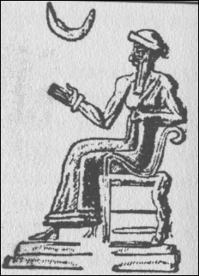
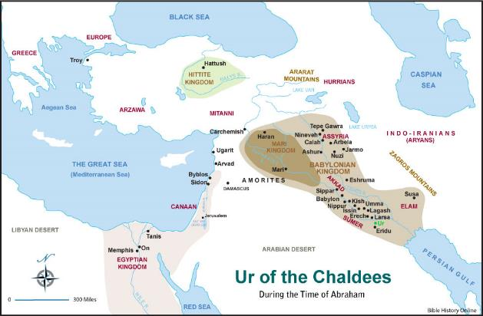
Moon god Sin
Ancient Mesopotamia worshipped a pantheon of mythical gods
They believed the moon god Sin ruled over all the gods
Sin had two principle seats of worship:
House of joys located in Harran
House of good lights located in Ur of Chaldean

Slide 4
Meet The Family
Genesis 11:27 – 11:32
Lot:
Son of Haran (Grandson of Terah)
Even though he is Abram’s nephew they were very close in age
Sarai
10-11 yrs younger than Abram and is his half sister
Married Abram in Ur of the Chaldeans
Unable to conceive

Slide 5
Where was Abram Called?
Genesis 12:1 – 12:5
Nehemiah 9:7-8 ⁷ “You are the Lord God, who chose Abram and brought him out of Ur of the Chaldeans and named him Abraham. ⁸ You found his heart faithful to you, and you made a covenant with him to give to his descendants the land of the Canaanites, Hittites, Amorites, Perizzites, Jebusites and Girgashites. You have kept your promise because you are righteous.
Acts 7: 2-4² To this he replied: “Brothers and fathers, listen to me! The God of glory appeared to our father Abraham while he was still in Mesopotamia, before he lived in Harran. ³ ‘Leave your country and your people,’ God said, ‘and go to the land I will show you. ⁴ “So he left the land of the Chaldeans and settled in Harran. After the death of his father, God sent him to this land where you are now living.

Slide 6
Abram’s Calling
Abram’s calling from God was independent of his family and so is ours
All of us have been jaded in some way by our families
Your family may affect your faith response

Slide 7
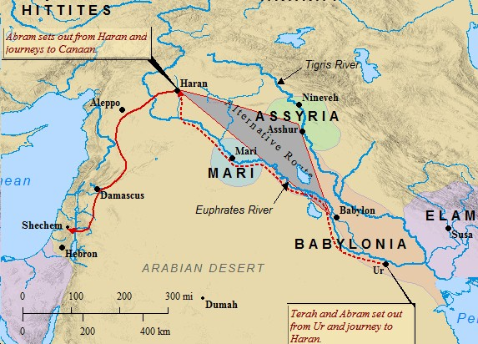
Map of Abram’s Journey

Slide 8
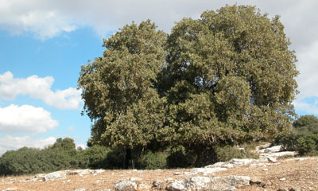
Abram’s Arrival
Genesis 12: 6-9
Abram’s arrival was met with his past
God used this as a defining moment in Abram’s life
Will we allow God to use our calling as a defining moment?
Joshua 24: 14-15

Slide 9
The Everlasting Covenant
Abram’s covenant with the Lord was unconditional
God’s covenant was fulfilled by the unconditional love of Jesus Christ
Galatians 3:29 If you belong to Christ then you are Abraham’s seed and heirs according to the promise.

Slide 10
Have you answered your Call?

