Slide 1
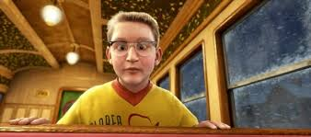
Art of Learning
November 5th, 2017

Slide 2
What Are You Going To Learn?

Slide 3
How Are We Going To Learn
Ask God for help:
⁴ Rejoice in the Lord always. I will say it again: Rejoice! ⁵ Let your gentleness be evident to all. The Lord is near. ⁶ Do not be anxious about anything, but in every situation, by prayer and petition, with thanksgiving, present your requests to God. ⁷ And the peace of God, which transcends all understanding, will guard your hearts and your minds in Christ Jesus.

Slide 4
How Are We Going To Learn
Put God’s word into practice:
⁸ Finally, brothers and sisters, whatever is true, whatever is noble, whatever is right, whatever is pure, whatever is lovely, whatever is admirable—if anything is excellent or praiseworthy—think about such things. ⁹ Whatever you have learned or received or heard from me, or seen in me—put it into practice. And the God of peace will be with you.

Slide 5
How Are We Going To Learn
Choose to learn now:
¹⁰ I rejoiced greatly in the Lord that at last you renewed your concern for me. Indeed, you were concerned, but you had no opportunity to show it. ¹¹ I am not saying this because I am in need, for I have learned to be content whatever the circumstances. ¹² I know what it is to be in need, and I know what it is to have plenty. I have learned the secret of being content in any and every situation, whether well fed or hungry, whether living in plenty or in want.

Slide 6
How Are We Going To Learn
Seek God’s Glory:
¹³ I can do all this through Christ who gives me strength.
Why are you seeking the scripture?
  To justify your current use or to serve the Lord?

Slide 7
Challenge To Each Of Us
Come prepared for Worship
Use this time as a precious gift from God
Own the responsibility to learn

Slide 8
What Could Happen?
It becomes infectious…
It opens doors to the new…

