Slide 1
The Authors of the Gospels
November 11th, 2018

Slide 2
Why Did God Pick These Four Authors?
Because they were not special and were certainly flawed
Because they received the Gospel with open hearts and responded
Because they had a unique message of the Gospel and could deliver the Gospel to targeted Audiences

Slide 3
Matthew The Tax Collector
Matthew was a sinner who did not hide from his sin
Matthew’s life allowed him to provide a bridge for Jews
Jesus needed a messenger that knew he needed to be saved and was willing to deliver it
That need is still here today. Are we willing to deliver the message?

Slide 4
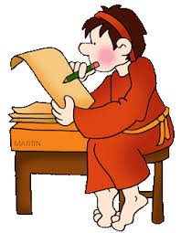
Mark The Deserter
Mark’s legacy was not defined by his failures but by his hearts desire to serve his Lord and Savior
Mark served, Paul, Barnabas, Peter, and most importantly our Lord. He saw the power of Christ and the void in the lives of Romans
His Gospel speak of the desire of our Lord and Savior to serve “Eutheos” (immediately). Do we have the same desire?

Slide 5
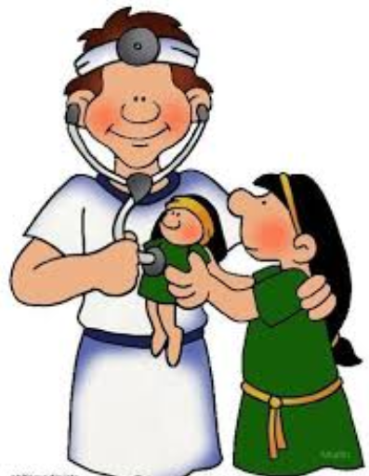
Luke the Physician
Luke’s humility showed in what he didn’t include in his Gospel
Luke was an outsider that wrote to include all mankind
Luke was a physician that saw the true life saving power of the Lord
Like Luke can we humble ourselves to see the humility and truth of Jesus?

Slide 6
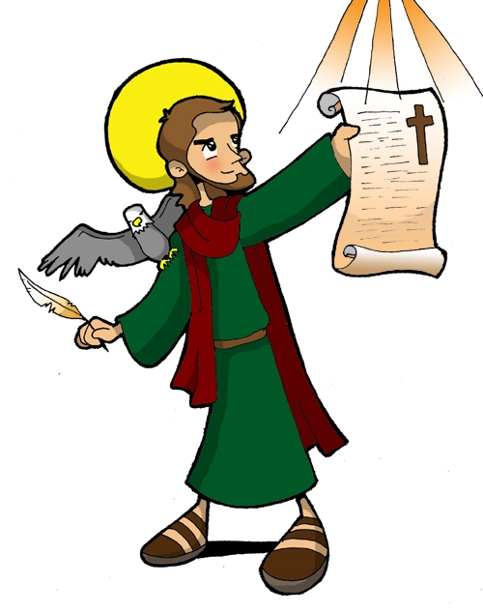
John the One Whom He Loved
John was passionate, ambitious, but reckless until Christ taught him humility and love
Through John’s Gospel we can learn to love like Christ
Through John’s Gospel we can learn to balance ambition with humility providing a witness of passion for Christ
Are we willing to find that kind of passion using the same source John did?

Slide 7
How Do We Become Author’s For Christ?
Like Matthew and Mark, we have to embrace where God has placed us and how we got there.
Like Luke and John, we have to have the effort and passion to deliver the message of the Gospel and do it with the love and humility they learned from Christ
God calls us now, what say you?

