Slide 1
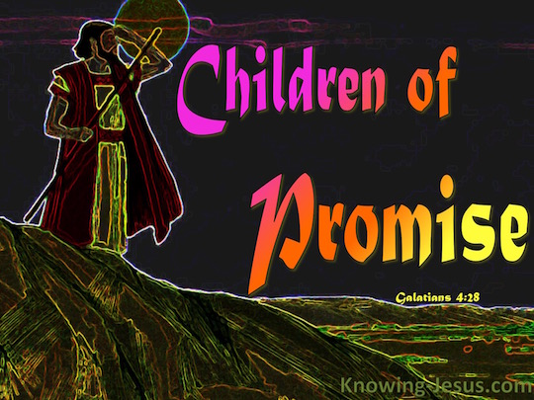
Committing to The Promise Part I Genesis Chapter 23
February 18th, 2018

Slide 2
A Place To Call Home
Be careful accepting free gifts from the world today, because the bill may be to much to bare tomorrow
To the world, God’s promise is a bargaining chip
To Abraham, God’s promise is the only deal to made

Slide 3
Abraham’s Investment
God’s promises to us are primarily future realities
To Abraham, this land was priceless because of what it meant spiritually
Those who believe, invest in what they cannot physically see
God’s promises aren’t defined by a single lifetime, but our investment is.

Slide 4
Live the promise as if it will be answered today even if that day never comes in our life. One day we too will stand beside Abraham in God’s country, our country…

