Slide 1
A Biblical Thriller
December 3rd, 2017

Slide 2
Vassal Cities
Genesis 14: 1-12
Team A Led by Kedorlaomer King of Elam
Allied with Araphel king of Shinar, Arioch King of Ellasar, and Tidal King of Goyim
Dominant force who ruled over most of the Canaan area providing “protection” for 12 years
Heavy taxes were levied on cities for exchange of protection against potential marauders
Team B made up of five cities in the Jordan River Valley
Sodom, Gomorrah, Admah, Zeboiim, and Zoar
Team B were considered Vassal Cities to Team A for 12 year until they rebelled in the 13th year
Summary of the conflict is basically a power struggle to ensure economic supremacy by controlling the most crucial trade route in the Mesopotamia region

Slide 3
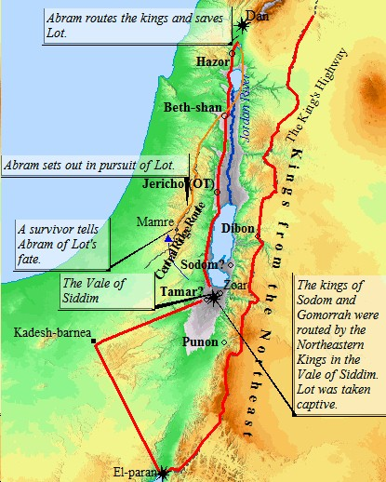

Slide 4
Resting On Your Laurels
Genesis 14: 13-16
Abram’s allies put their faith in God’s Promise
Abram prepared his household to do God’s work
What we do during our times of peace will dictate our choices at times of war
Proverbs 22:1-6; Titus 2:1-8

Slide 5
Abram had a Lot to Gain
God fearing people do not judge those in need
James 2:14-17; Luke 6:37-42
Faith in God’s Promise allows you to act boldly in the face of wickedness
Matthew 17:20
Hearts belonging to God are not for sale
Genesis 14: 17-24

Slide 6
Learn from Abram
Giving is a heart reaction to acknowledgement of the glory of God
2 Corinthians 9:7
Praising God for the blessings in our lives is contagious

Slide 7
In all your ways acknowledge Him, And He will make your paths straight – Proverbs 3:6

